Slide 1
Levels of organisation
Wenting Chai

Slide 2
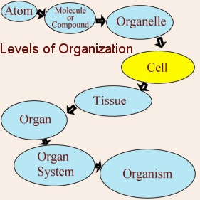
Levels of organization
Similar cells that do similar jobs are gathered together into tissues.
More complicated organisms have organs that are made up of a number of tissues.
Groups of organs work together in organ systems to carry out certain functions.
Put all of the body’s systems together and you get an organism. That’s you!

Slide 3
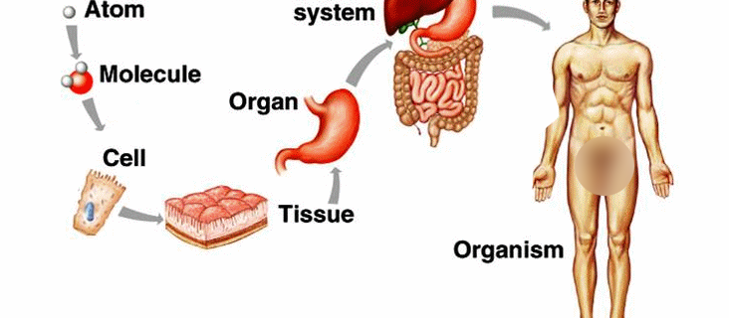
Levels of organization
Human digestive system
We will learn more about human digestive system in C7

Slide 4

Tissues
The cells of a tissue may be of the same type, such as palisade tissue or spongy tissue of a leaf.
The cells may be of mixed type, such as phloem in angiosperms/ flowering plants which is made of 4 different types of cells [(1) sieve element, (2) companion cell, (3) phloem sclerenchyma, and (4) phloem parenchyma], and bone, blood, muscle, nerves, and connective tissue in animals.

Slide 5
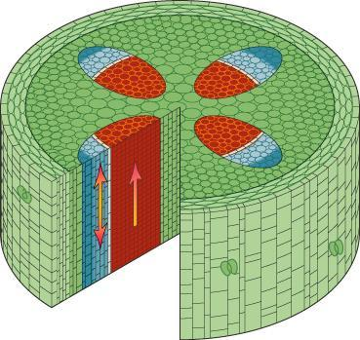
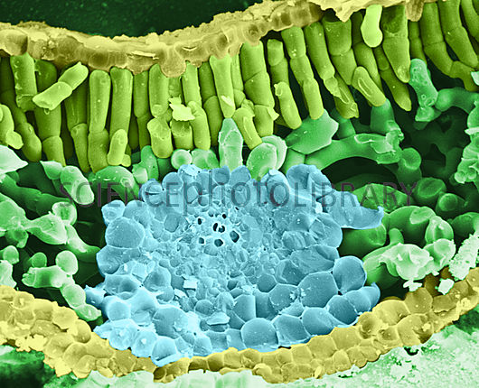
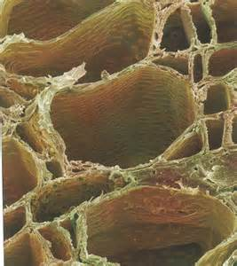
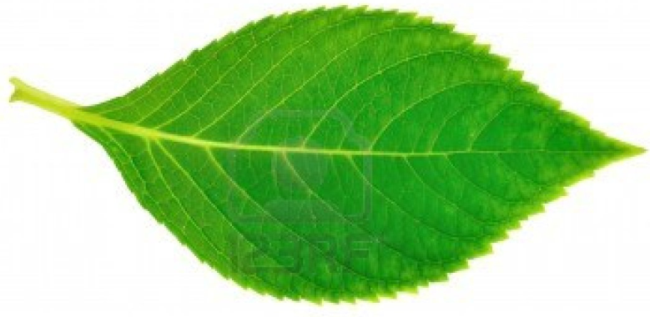
Some examples of plant tissues
Xylem vessels
Upper epidermis
Palisade tissues
Spongy tissues
Vascular tissues
Lower epidermis
Cross/ transverse section of a leaf
We will learn more about plant structures in C8

Slide 6
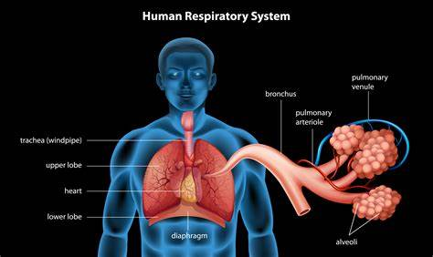
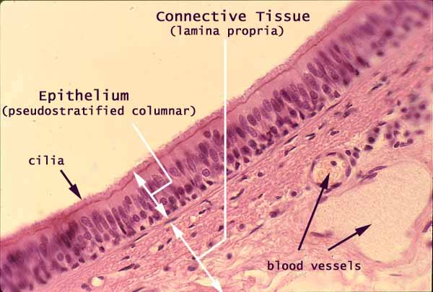
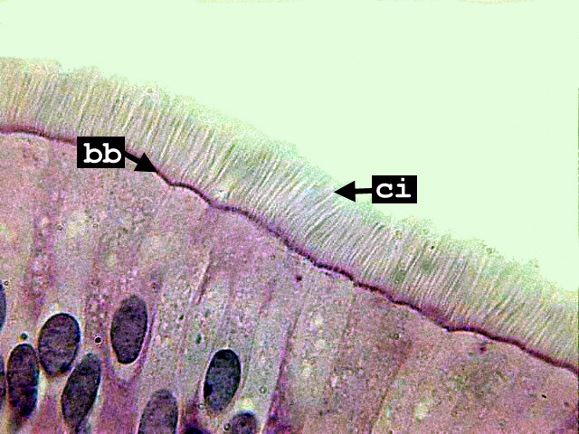
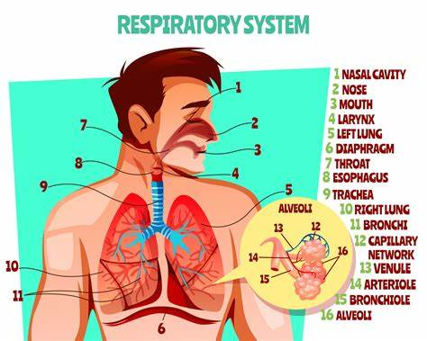
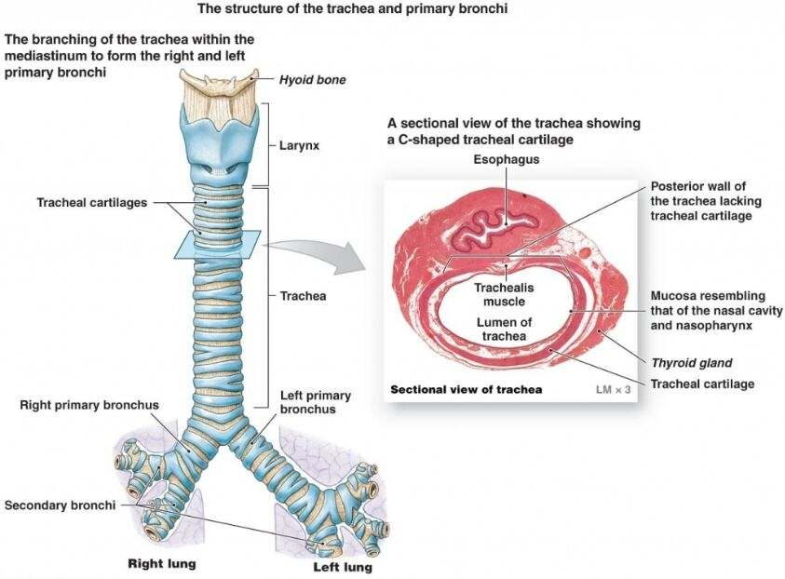
Some examples of animal tissues
The lining of trachea/ respiratory passage
Ciliated cell
cilia
We will learn more about human respiratory system in C11

Slide 7
Four basic types of tissues in animals/ human
Nervous tissue
Epithelial tissue
Muscular tissue
Connective tissue
https://www.thoughtco.com/connective-tissue-anatomy-373207
As the name implies, connective tissue serves a connecting function: It supports and binds other tissues in the body.
Unlike epithelial tissue, which has cells that are closely packed together, connective tissue typically has cells scattered throughout an extracellular matrix of fibrous proteins and glycoproteins attached to a basement membrane.
The primary elements of connective tissue include a ground substance, fibers, and cells.

Slide 8
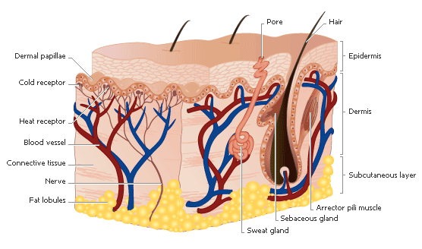
Organs
Made of different types of tissues that work together to perform a specific function.

Slide 9
Organs
Animal
Plant
Tongues
Eyes
Fingers
Kidneys
Small intestine
Skin
Brain
fingers
Root
Stem
Leaves
Flowers
Fruits
Seeds
Stamens
petals

Slide 10
Organ systems
E.g.
Nervous system
Digestive system
Urinary system
Reproductive system
Cardiovascular system
(circulatory system)
Respiratory system
Endocrine system

Slide 11
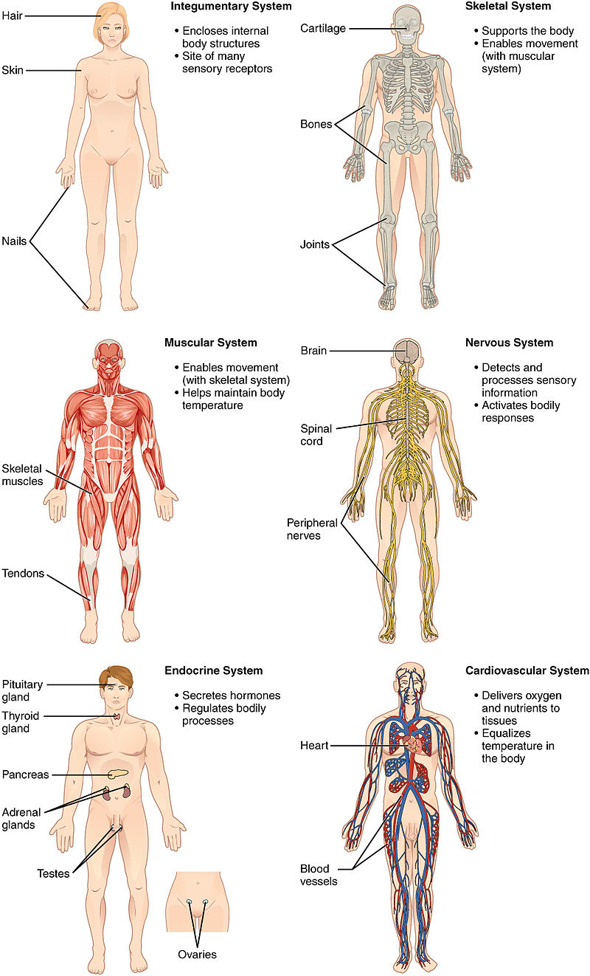

Slide 12
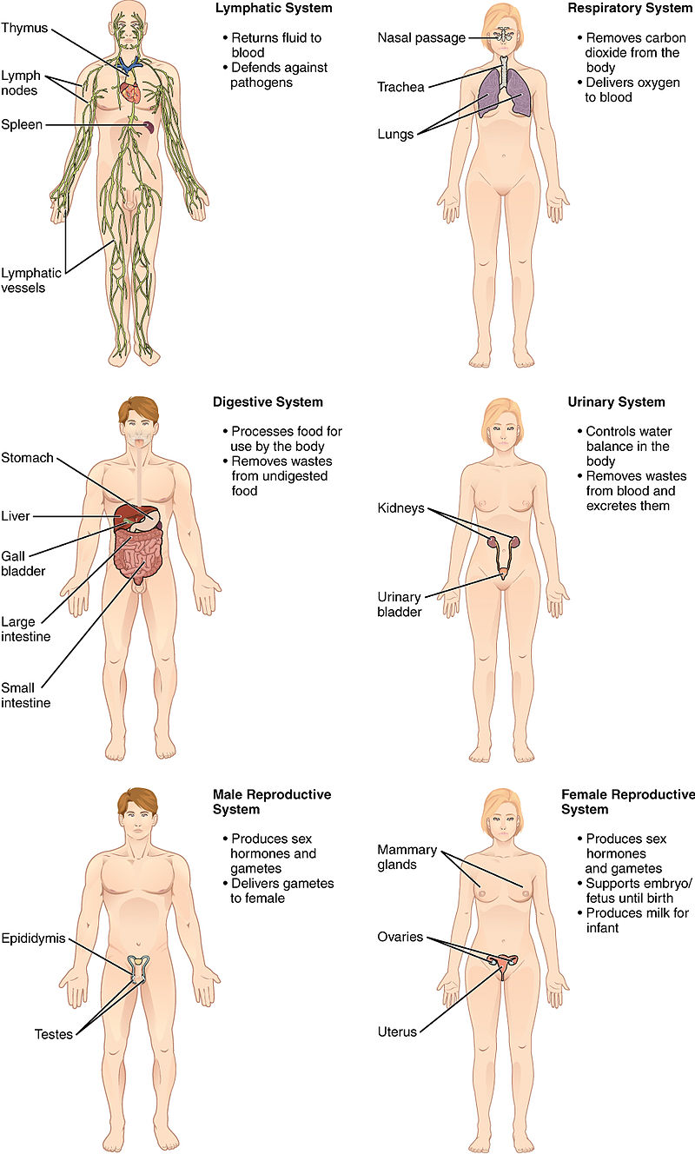

Slide 14
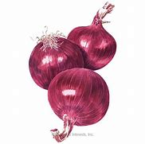
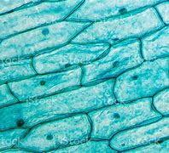
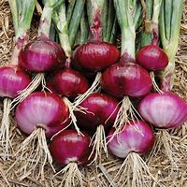
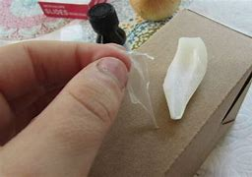
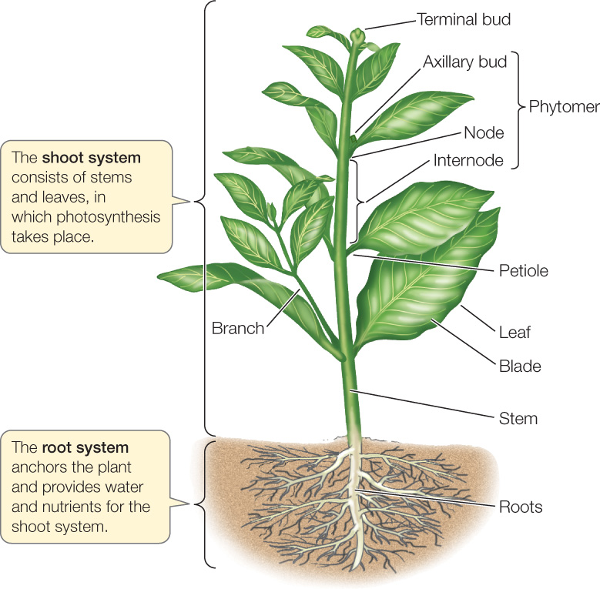
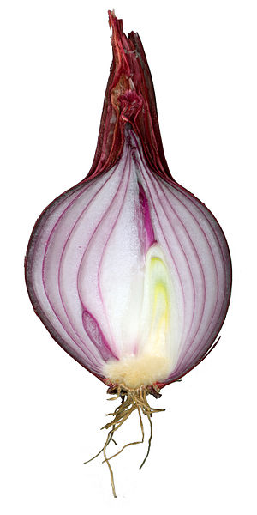
Practice
onion epidermal cells
onion plant
onion bulb
onion epidermis
Task: Can you arrange the 4 pictures: onion bulb, onion epidermal cells, onion plant, onion epidermis, plus the shooting system of onion, in order of size, starting from the smallest.

